Slide 1
FUNDAMENTALS OF SOFTWARE PROJECT MANAGEMENT
Estimation
Week - 7

Slide 2
Objectives
Estimation
  taxonomy of Estimation Methods
    Top-down
    Bottom-up - activity based, analytical
    Parametric or algorithmic models e.g. function points (using formulas and equations)
    Expert opinion - just guessing?
    Analogy - case-based, comparative
    Parkinson and ‘price to win’

Slide 3
Estimations
Very difficult to do, but needed often
Created, used or refined during
  Strategic planning
  Feasibility study and/or SOW
  Proposals
  Vendor and sub-contractor evaluation
  Project planning (iteratively)
Basic process
  Estimate the size of the product
  Estimate the effort (man-months)
  Estimate the schedule
  NOTE: Not all of these steps are always explicitly performed

Slide 4
Estimations
Remember, an “exact estimate” is an oxymoron
Estimate how long will it take you to get home from class tonight
  On what basis did you do that?
  Experience right?
  Likely as an “average” probability
  For most software projects there is no such ‘average’
Most software estimations are off by 25-100%
Notes:
An oxymoron is a self-contradicting word or group of words

Slide 5
Estimation
Target vs. Committed Dates
    Target: Proposed by business or marketing
    Do not commit to this too soon!
    Committed: Team agrees to this
    After you’ve developed a schedule

Slide 6
What makes a successful project?
Delivering:
agreed functionality
on time
at the agreed cost
with the required quality
Stages:
set targets
Attempt to achieve targets
BUT what if the targets are not achievable?
Notes:
A key point here is that developers may in fact be very competent, but incorrect estimates leading to unachievable targets will lead to extreme customer dissatisfaction.

Slide 7
Some problems with estimating
Subjective nature of much of estimating
  It may be difficult to produce evidence to support your precise target
Political pressures
  Managers may wish to reduce estimated costs in order to win support for acceptance of a project proposal
Changing technologies
  these bring uncertainties, especially in the early days when there is a ‘learning curve’
Projects differ
  Experience on one project may not be applicable to another
Notes:
Section 5.1. of the textbook.
Exercise 5.1 where the reader is asked to calculate productivity rates for activities on a real project illustrates some of the difficulties of interpreting project data.

Slide 8
Basis for successful estimating
Information about past projects
  Need to collect performance details about past project: how big were they? How much effort/time did they need?
Need to be able to measure the amount of work involved
  Traditional size measurement for software is ‘lines of code’ – but this can have problems
Notes:
Despite our reservation about past project data –see slide 3 - we still need to collect and analyse it! If we don’t know how big the job is, we can’t estimate how long it will take to do.

Slide 9
A taxonomy of Estimation Methods
Top-down
Bottom-up - activity based, analytical
Parametric or algorithmic models e.g. function points (using formulas and equations)
Expert opinion - just guessing?
Analogy - case-based, comparative
Parkinson and ‘price to win’
Notes:
This taxonomy is based loosely on Barry Boehm’s in the big blue book, ‘Software Engineering Economics’.
One problem is that different people call these approaches by different names. In the case of bottom-up and analogy some of the alternative nomenclatures have been listed.
‘Parkinson’ is setting a target based on the amount of staff effort you happen to have available at the time. ‘Price to win’ is setting a target that is likely to win business when tendering for work. Boehm is scathing about these as methods of estimating. However, sometimes you might have to start with an estimate of an acceptable cost and then set the scope of the project and the application to be built to be within that cost.
This is discussed in Section 5.5 of the textbook.

Slide 10
Top-down Estimation
Based on overall characteristics of project
  Some of the others can be “types” of top-down (Analogy, Expert Judgment, and Algorithmic methods)
Advantages
  Easy to calculate
  Effective early on (like initial cost estimates)
Disadvantages
  Some models are questionable or may not fit
  Less accurate because it doesn’t look at details

Slide 11
Top-down estimates
Produce overall estimate using effort driver(s)
distribute proportions of overall estimate to components
Estimate
100 days
overall
project
design
code
test
30%
i.e.
30 days
30%
i.e.
30 days
40%
i.e. 40 days
Notes:
The initial overall estimate might have been produced using a parametric model, by analogy or just expert judgement.

Slide 12
Bottom-up estimating
1. Break project into smaller and smaller components
2. Stop when you get to what one person can do in one/two weeks
3. Estimate costs for the lowest level activities
4. At each higher level calculate estimate by adding estimates for lower levels
Notes:
The idea is that even if you have never done something before you can imagine what you could do in about a week.
Exercise 5.3 relates to bottom-up estimating

Slide 13
Bottom-up Estimation
Create WBS
Add from the bottom-up
Advantages
  Works well if activities well understood
Disadvantages
  Specific activities not always known
  More time consuming

Slide 14
Bottom-up versus top-down
Bottom-up
  use when no past project data
  identify all tasks that have to be done – so quite time-consuming
  use when you have no data about similar past projects
Top-down
  produce overall estimate based on project cost drivers
  based on past project data
  divide overall estimate between jobs to be done
Notes:
There is often confusion between the two approaches as the first part of the bottom-up approach is a top-down analysis of the tasks to be done, followed by the bottom-up adding up of effort for all the work to be done. Make sure you students understand this or it will return to haunt you (and them) at examination time.

Slide 15
Expert judgement
Asking someone who is familiar with and knowledgeable about the application area and the technologies to provide an estimate
Particularly appropriate where existing code is to be modified
Research shows that experts judgement in practice tends to be based on analogy
Notes:
Section 5.8
Use somebody who has recent experience on a similar project
You get a “guesstimate”
Accuracy depends on their ‘real’ expertise
Comparable application(s) must be accurately chosen
Systematic
Can use a weighted-average of opinions

Slide 16
Estimation by Analogy
Use past project
  Must be sufficiently similar (technology, type, organization)
  Find comparable attributes (ex: # of inputs/outputs)
  Can create a function
Advantages
  Based on actual historical data
Disadvantages
  Difficulty ‘matching’ project types
  Prior data may have been mis-measured
  How to measure differences – no two exactly same

Slide 17
Estimating by analogy
Use effort
from source as
estimate
source cases
attribute values
effort
attribute values
effort
target case
attribute values
effort
attribute values
?????
attribute values
effort
attribute values
effort
attribute values
effort
Select case
with closet attribute
values
Notes:
The source cases, in this situation, are completed projects. For each of details of the factors that would have a bearing on effort are recorded. These might include lines of code, function points (or elements of the FP counts such as the number of inputs, outputs etc), number of team members etc etc. For the values for the new project are used to find one or more instances from the past projects than match the current one. The actual effort from the past project becomes the basis of the estimate for the new project.

Slide 18
Stages: identify
Significant features of the current project
previous project(s) with similar features
differences between the current and previous projects
possible reasons for error (risk)
measures to reduce uncertainty

Slide 19
Priced to Win
Just follow other estimates
Save on doing full estimate
Needs information on other estimates (or prices)
Purchaser must closely watch trade-offs
Priced to lose?
Notes:
Pricing to win The software cost is estimated to be whatever the customer has available to spend on the project.

Slide 20
Over and under-estimating
Parkinson’s Law: ‘Work expands to fill the time available’
An over-estimate is likely to cause project to take longer than it would otherwise
Weinberg’s Zeroth Law of reliability: ‘if a system does not have to be reliable, it can meet any other objective’
Notes:
The answer to the problem of over-optimistic estimates might seem to be to pad out all estimates, but this itself can lead to problems. You might miss out to the competition who could underbid you, if you were tendering for work. Generous estimates also tend to lead to reductions in productivity. On the other hand, having aggressive targets in order to increase productivity could lead to poorer product quality.
Ask how many students have heard of Parkinson’s Law – the response could be interesting! It is best to explain that C. Northcote Parkinson was to some extent a humourist, rather than a heavyweight social scientist.
Note that ‘zeroth’ is what comes before first.
This is discussed in Section 5.3 of the text which also covers Brooks’Law.

Slide 21
Over and Under Estimation
Over estimation issues
  The project will not be funded
    Conservative estimates guaranteeing 100% success may mean funding probability of zero.
  Parkinson’s Law: Work expands to take the time allowed
  Danger of feature and scope creep
  Be aware of “double-padding”: team member + manager
Under estimation issues
  Quality issues (short changing key phases like testing)
  Inability to meet deadlines
  Morale and other team motivation issues

Slide 22
Algorithmic/Parametric models
COCOMO (lines of code) and function points examples of these
Problem with COCOMO etc:
guess
algorithm
estimate
but what is desired is
system
characteristic
algorithm
estimate
Notes:
The problems with COCOMO is that the input parameter for system size is an estimate of lines of code. This is going to have to be an estimate at the beginning of the project.
Function points, as will be seen, counts various features of the logical design of an information system and produced an index number which reflects the amount of information processing it will have to carry out. This can be crudely equated to the amount of code it will need.

Slide 23
Parametric models - the need for historical data
simplistic model for an estimate
estimated effort = (system size) / productivity
e.g.
  system size = lines of code
  productivity = lines of code per day
productivity = (system size) / effort
  based on past projects
Notes:
This is analogous to calculating speed from distance and time.

Slide 24
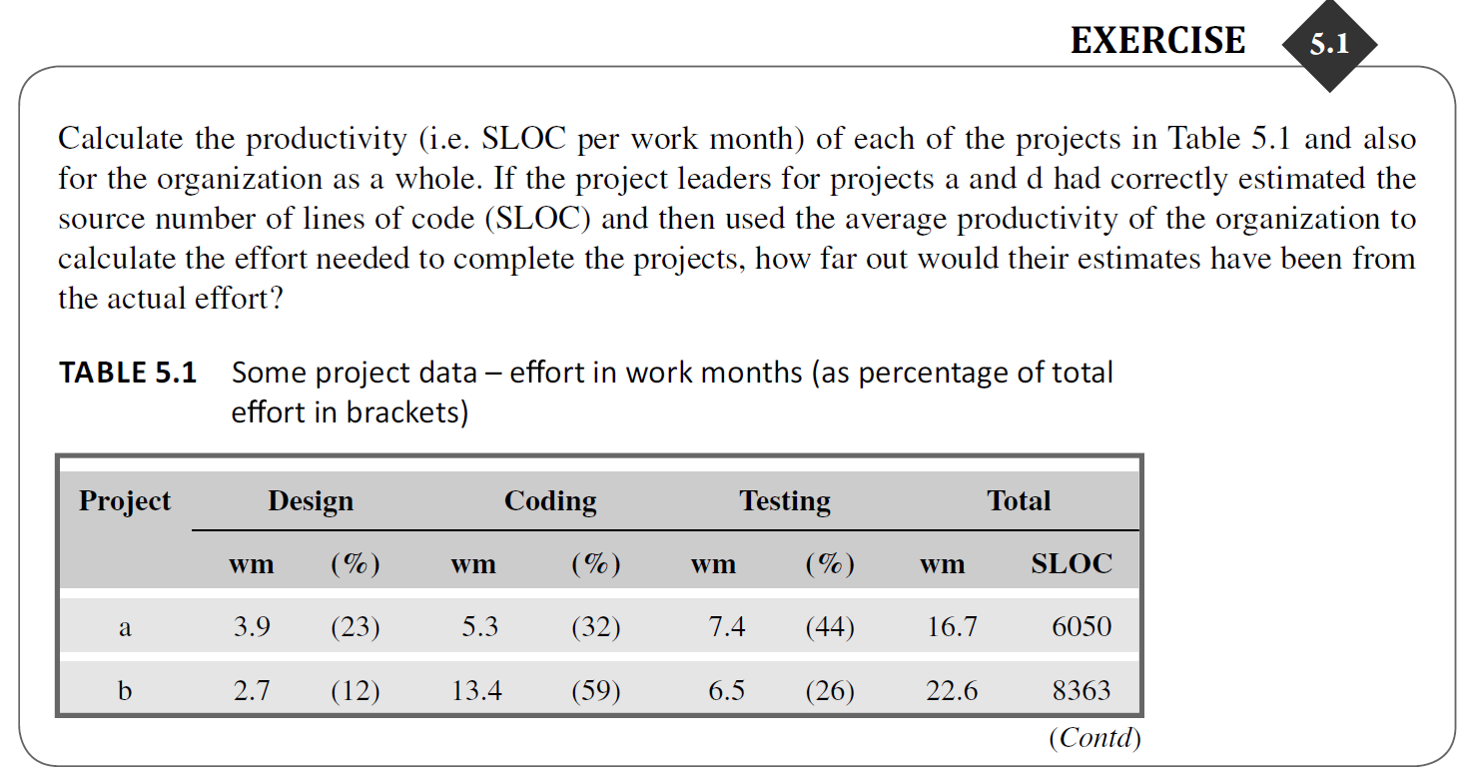
Notes:
When you calculate productivity rates for activities on a real project, you're attempting to measure how efficiently resources are being utilized to complete specific tasks or activities.

Slide 25
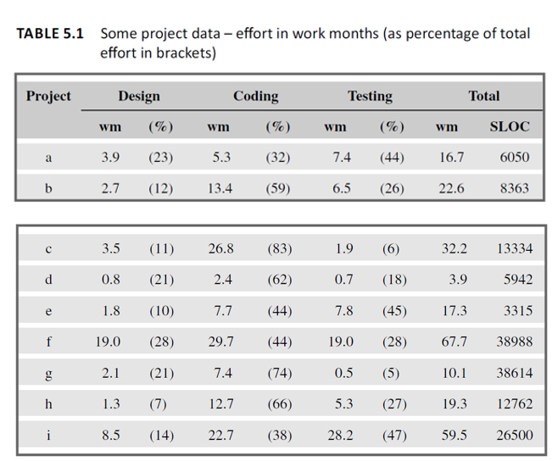
Notes:
By taking the estimated size of the project (in SLOC) and dividing by the productivity rate, you get an initial estimate of the total work months required.

Slide 26
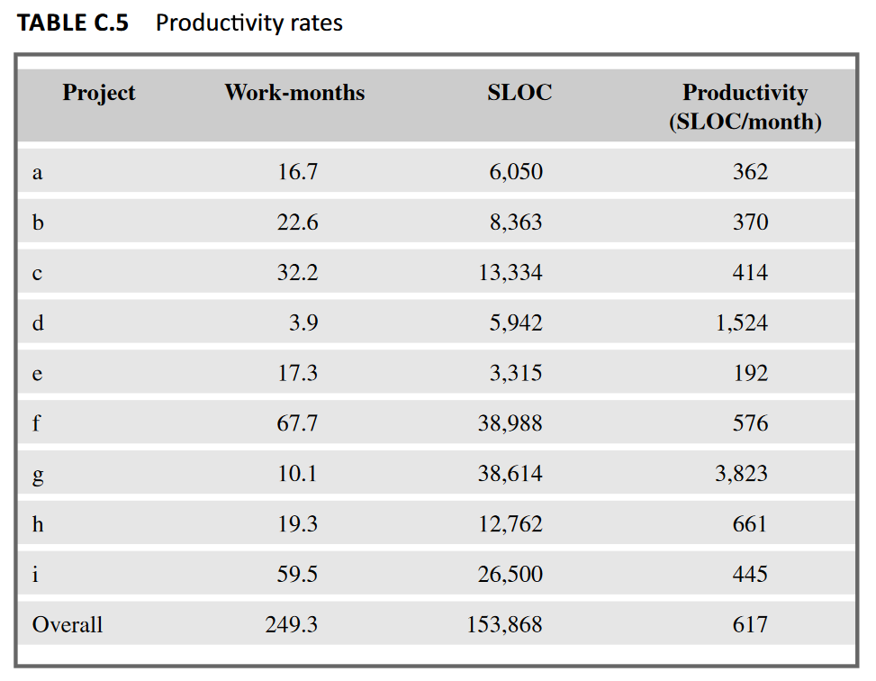
Notes:
Overall, calculating productivity rate provides valuable data for project managers. It helps with planning, resource allocation, risk assessment, and ultimately, delivering projects on time and within budget.
Overall productivity = 153868 SLOC / 249.3 work months = 617 SLOC per work month

Slide 27
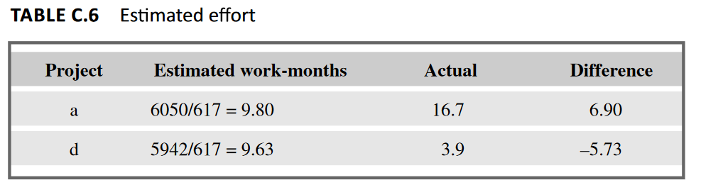
This highlights the importance of accurate SLOC estimation for better project effort forecasting.
Notes:
If the table doesn't provide the estimated SLOC for projects a and d. However, we can calculate the effort needed to complete these projects if the average productivity (617 SLOC per work month) was used.
Effort for project a (estimated): 6050 SLOC / 617 SLOC per work month = 9.80 work months
Effort for project d (estimated): 5942 SLOC / 617 SLOC per work month = 9.63 work months
Difference for project a: Actual effort (16.7 work months) - Estimated effort (9.80 work months) = 6.90 work months [over estimated]
Difference for project d: Actual effort (3.9 work months) - Estimated effort (9.63 work months) = -5.73 months [under estimated]

Slide 28
Parametric models
Some models focus on task or system size e.g. Function Points
FPs originally used to estimate Lines of Code, rather than effort
Number
of file types
  model
‘system
size’
Numbers of input
and output transaction types
Notes:
‘System size’ here can be seen as an index that allows the size of different applications to be compared. It will usually correlate to the number of lines of code required.

Slide 29
Parametric models
Other models focus on productivity: e.g. COCOMO
Lines of code (or FPs etc) an input
System
size
Estimated effort
Productivity
factors
Notes:
COCOMO originally was based on a size parameter of lines of code (actually ‘thousand of delivered sourcecode instructions’ or kdsi). Newer versions recognize the use of functions points as a size measure, but convert them to a number called ‘equivalent lines of code (eloc).

Slide 30
Algorithmic/Parametric Measures
Lines of Code (LOC)
Function points
Feature points or object points
Other possible
  Number of bubbles on a DFD
  Number of of ERD entities
  Number of processes on a structure chart
LOC and function points most common
  (of the algorithmic approaches)
Majority of projects use none of the above

Slide 31
Code-based Estimates
LOC Advantages
  Commonly understood metric
  Permits specific comparison
  Actuals easily measured
LOC Disadvantages
  Difficult to estimate early in cycle
  Counts vary by language
  Many costs not considered (ex: requirements)
  Programmers may be rewarded based on this
    Can use: # defects/# LOC
  Code generators produce excess code

Slide 32
LOC Estimate Issues
How do you know how many in advance?
What about different languages?
What about programmer style?
Stat: avg. programmer productivity: 3,000 LOC/yr
Most algorithmic approaches are more effective after requirements (or have to be after)

Slide 33
Function Points
Software size measured by number & complexity of functions it performs
More methodical than LOC counts
House analogy
  House’s Square Feet ~= Software LOC
  # Bedrooms & Baths ~= Function points
  Former is size only, latter is size & function

Slide 34
Function Point Process
1. Count # of biz functions per category
  Categories: outputs, inputs, db inquiries, files or data structures, and interfaces
2. Establish Complexity Factor for each and apply
  Simple, Average, Complex
  Set a weighting multiplier for each (0->15)
  This results in the “unadjusted function-point total”
3. Compute an “influence multiplier” and apply
  It ranges from 0.65 to 1.35; is based on 14 factors
4. Results in “function point total”
  This can be used in comparative estimates

Slide 35
Parametric Method Issues
Remember: most projects you’ll run into don’t use these
Which is ‘normal’, so don’t be surprised
  Or come-in to new job and say “Hey, let’s use COCOMO”
These are more effective on large projects
  Where a past historical base exists
Primary issue for most projects are
  Lack of similar projects
    Thus lack of comparable data
Catch: how to get started

Slide 36
Code Reuse & Estimation
Does not come for free
Code types: New, Modified, Reused
If code is more than 50% modified, it’s “new”
Reuse factors have wide range
  Reused code takes 30% effort of new
  Modified is 60% of new
Integration effort with reused code almost as expensive as with new code

Slide 37
Effort Estimation
Now that you know the “size”, determine the “effort” needed to build it
Various models: empirical, mathematical, subjective
Expressed in units of duration
  Man-months (or ‘staff-months’ now)

Slide 38
Effort Estimation
McConnell shows schedule tables for conversion of size to effort
As with parametric size estimation, these techniques perform better with historical data
Again, not seen in ‘average’ projects
Often the size and effort estimation steps are combined (not that this is recommended, but is what often is done)
“Commitment-Based” Scheduling is what is often done
  Ask developer to ‘commit’ to an estimate (his or her own)

Slide 39
COCOMO
COnstructive COst MOdel
Allows for the type of application, size, and “Cost Drivers”
Outputs in Person Months
Cost drivers using High/Med/Low & include
  Motivation
  Ability of team
  Application experience
Biggest weakness?
  Requires input of a product size estimate in LOC

Slide 40
Estimation Guidelines
Estimate iteratively!
  Process of gradual refinement
  Make your best estimates at each planning stage
  Refine estimates and adjust plans iteratively
  Plans and decisions can be refined in response
  Balance: too many revisions vs. too few

Slide 41
Know Your Deadlines
Are they ‘Real Deadlines’?
  Tied to an external event
  Have to be met for project to be a success
  Ex: end of financial year, contractual deadline
Or ‘Artificial Deadlines’?
  Set by arbitrary authority
  May have some flexibility (if pushed)

Slide 42
Other Estimation Notes
Remember: “manage expectations”
Parkinson’s Law
  “Work expands to fill the time available”
The Student Syndrome
  Procrastination until the last minute (cram)

Slide 43
Some conclusions: how to review estimates
Ask the following questions about an estimate
What are the task size drivers?
What productivity rates have been used?
Is there an example of a previous project of about the same size?
Are there examples of where the productivity rates used have actually been found?

